Slide 1
機器學習期末報告
7108053107
陳冠霖

Slide 2
目錄
實作結果
FaceNet2ExpNet: Regularizing a Deep Face Recognition Net for Expression Recognition
2017 IEEE 12th International Conference on Automatic Face & Gesture Recognition
Learning a Discriminative Filter Bank within a CNN for Fine-grained Recognition
2018 CVPR

Slide 3
FaceNet2ExpNet: Regularizing a Deep Face Recognition Net for Expression Recognition
Hui Ding, Shaohua Kevin Zhou and Rama Chellappa
2017 IEEE 12th International Conference on Automatic Face & Gesture Recognition

Slide 4
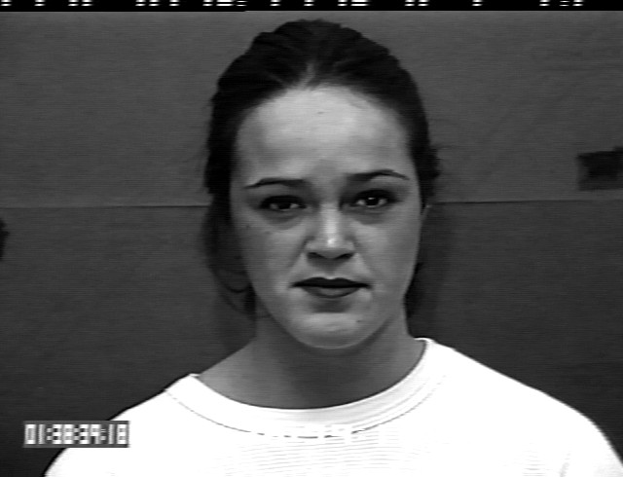



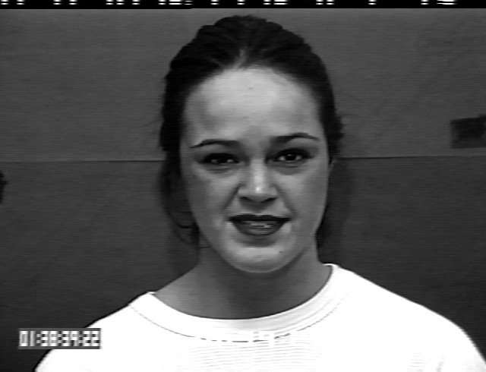

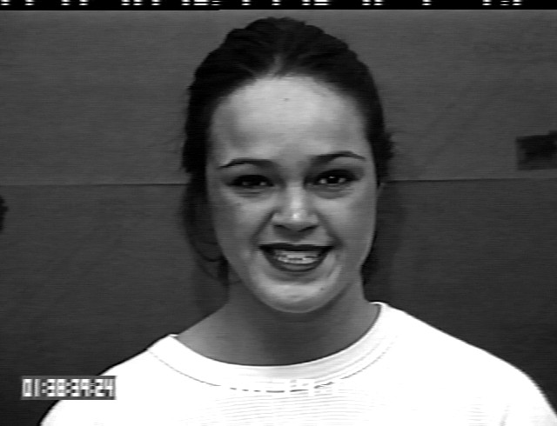






Data – CK+
Input size：224*224*3 RGB image
Output：八種表情 ( 中性(0)、憤怒(1)、厭惡(2)、恐懼(3)、高興(4)、悲傷(5)、驚訝(6)、鄙視(7) )
Output label : ex: ( 0.1 , 0.1 , 0.2 , 0.3 , 0.2 , 0.1 , 0 , 0 )
Input label : ex:(1,0,0,0,0,0,0,0)
Data：
Train data：1812 張( 90% train、10% validation )
Test data：150 張

Slide 5

model
Conv
+ max pooling
+ ReLu
Fine-tuned
VGG conv.
Loss : ${\text{‖}\text{facenet}\text{（}\text{I}\text{）−}\text{emotionnet}\text{（}\text{I}\text{）}\text{‖}}_{F}$
224
224
112*112*64
56*56*128
28*28*256
14*14*512
7*7*512
1*1 conv.
+ ReLu
Fc
+softmax
Fc
Loss : cross entropy
7*7*1
256
8

Slide 6
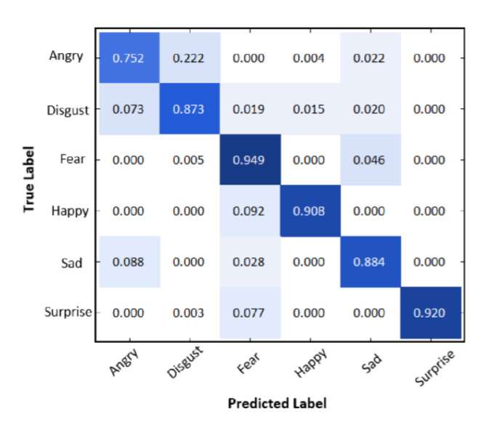
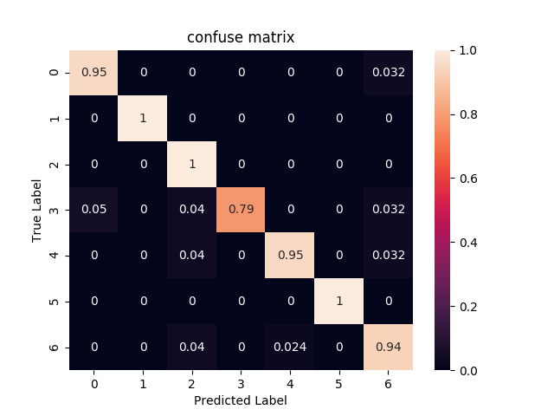
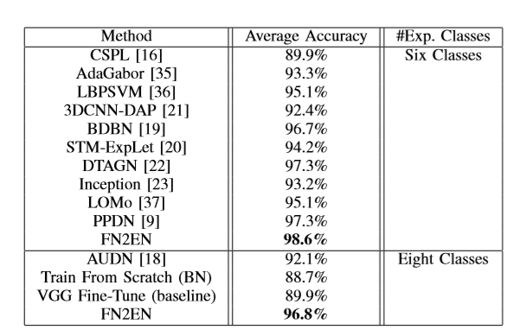
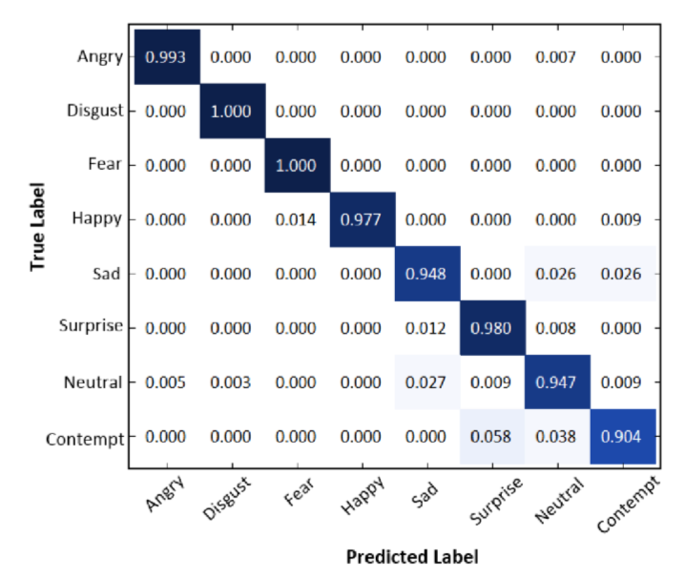
result
paper
實驗結果

Slide 7
Learning a Discriminative Filter Bank within a CNN for Fine-grained Recognition
Yaming Wang , Vlad I. Morariu , Larry S. Davis
2018 CVPR

Slide 8
model
GMP：global maximum pooling
Total epoch：50
Activation function: Relu
Optimizer：Adam
Learning rate：1e-4
Loss：cross entropy
Batch_size：16
Side Branch
8
1*1*8
softmax
t
Cross-channel pool
L
*0.1
P - Stream
Fc+
softmax
8
Conv6
GMP
t
Vgg16 conv.
pool6
*1
L
L
224
28*28*2000
1*1*2000
G - Stream
Fc+
softmax
8
Conv5
t
VGG16的前十層
*1
L
224
28*28*200
Train data：1812 張 (224*224*3)
90% ➔ train , 10% ➔ validation
Test data：150 張 (224*224*3)

Slide 9
GMP：global maximum pooling
Side Branch
8
1*1*8
softmax
t
Cross-channel pool
L
*0.1
P - Stream
Fc+
softmax
8
Conv6
GMP
t
Vgg16 conv.
pool6
*1
L
L
224
28*28*2000
1*1*2000
G - Stream
Fc+
softmax
8
Conv5
t
VGG16的前十層
*1
L
224
28*28*200
前提：
1. G 跟其他路線分開
2. S&P 有關連
假設：
1. data很複雜，導致S&P不好學習
策略：
1. S的不分先做，著重在CONV6的學習，後做P

Slide 10
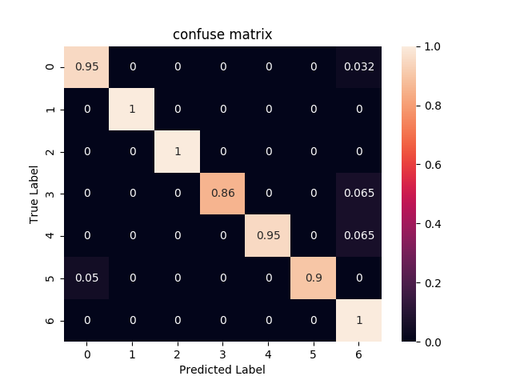
result
paper
實驗結果

